Slide 1
FWD Project
TOGAF 9 - Core Diagrams Business Services and Information Diagram Phase B – Business Architecture

Slide 2
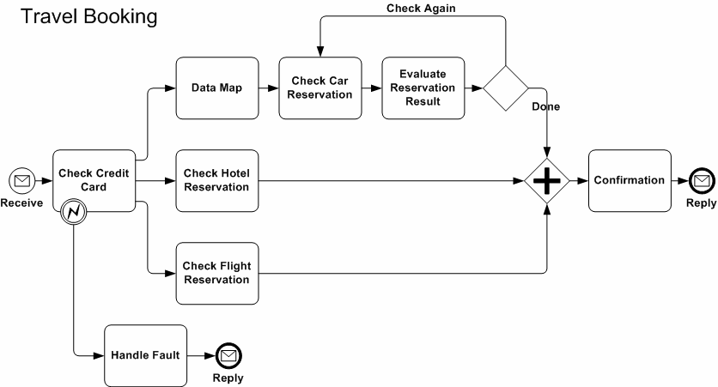
Business Services and Information Diagram

Slide 3
Business Services and Information Diagram

Slide 4
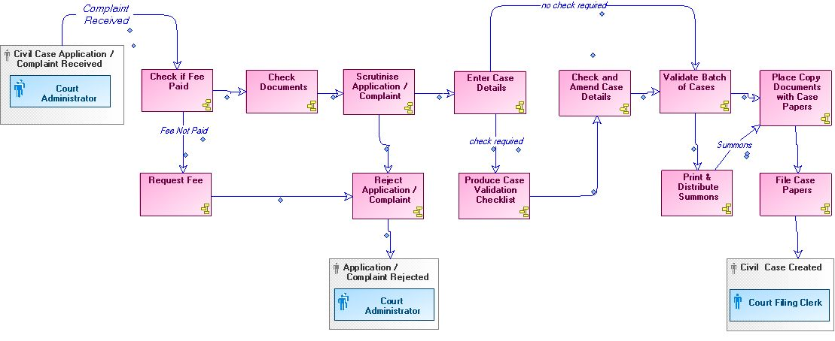
Business Services and Information Diagram

